Slide 1
PROJECT PRESENTATION
AI-Based Health Risk
Prediction System
Using Lifestyle Data & Explainable Machine Learning
Team Members: B.Kowshik Reddy(2303A52013)
Batch: Batch-31 | Institution: SR University| Academic Year: 2025–26
Department of CS&AI

Slide 2
Introduction
Problem Statement
70%
Chronic diseases like diabetes, cardiovascular disorders, and hypertension are responsible for over 70% of global deaths. Early prediction based on lifestyle patterns can save millions of lives.
Traditional diagnosis is:
• Reactive (post-symptom)
• Expensive and time-consuming
• Inaccessible in rural/low-income areas
This project proposes an AI-powered system that leverages routine lifestyle data — diet, sleep, exercise, BMI, and more — to predict health risks proactively.
Deaths from
chronic disease
1.5B
People with
preventable conditions
3×
Faster prediction
vs. traditional
Source: WHO Global Health Statistics 2024

Slide 3
Objectives
01
Predict Health Risks
02
Explainability (XAI)
Build a multi-class ML model to classify users into Low, Medium, or High health risk categories based on lifestyle inputs.
Use SHAP values and LIME to explain individual predictions, ensuring trust and transparency for end-users and clinicians.
03
User-Friendly Interface
04
Model Performance
Develop a web/mobile interface where users input their lifestyle data and receive actionable, personalized health recommendations.
Achieve ≥90% accuracy on benchmark datasets (NHANES, UCI Heart Disease) using ensemble ML techniques.
05
Data Privacy
06
Continuous Learning
Ensure all user data is anonymized and processed in compliance with HIPAA and GDPR standards.
Design a retraining pipeline so the model improves as new data is collected from user interactions.

Slide 4
Stakeholders
👤 General Public
🏥 Healthcare Providers
📋 Insurance Companies
Individuals who want to monitor their health and receive early warnings about potential lifestyle-related diseases.
Doctors and clinicians who use AI predictions as a decision-support tool for early intervention and triage.
Health insurers who can use risk scores to customize premiums and encourage preventive care programs.
🏛 Government & NGOs
🔬 Researchers
Public health departments that use aggregated data to design disease prevention campaigns and policies.
Medical researchers studying correlations between lifestyle factors and chronic disease incidence at population level.

Slide 5
Programming Languages, Tools & Software
Languages
ML Libraries
Data & Viz
▸ Python 3.10
▸ JavaScript (ES6+)
▸ HTML5 / CSS3
▸ Scikit-learn
▸ XGBoost / LightGBM
▸ SHAP
▸ LIME
▸ Imbalanced-learn
▸ Pandas
▸ NumPy
▸ Matplotlib
▸ Seaborn
▸ Plotly
Web & Backend
AI Tools
Dev & Deploy
▸ Flask / FastAPI
▸ React.js
▸ REST API
▸ ChatGPT (prompting)
▸ GitHub Copilot
▸ Hugging Face
▸ GitHub
▸ Jupyter Notebook
▸ VS Code

Slide 6
Prompts Used to Generate Code
P1
"""
"Create a main.py file that orchestrates the complete SmartHealth AI pipeline:
1. Load the health dataset from CSV
2. Create disease_risk target variable by combining heart_disease, diabetes, stroke
3. Run EDA visualization on the dataset
4. Train an XGBoost model with 200 estimators for risk classification
5. Generate SHAP explainability analysis
6. Save all outputs to outputs/ directory
Make it production-ready with clear progress indicators and error handling."
PURPOSE:
────────
Orchestrates the complete end-to-end ML workflow:
• EDA → Preprocessing → Model Training → Explainability Analysis
• Loads 5,000 patient health records
• Creates 12-feature ML model
• Generates 7 visualization outputs
• Provides SHAP model interpretability
COMPLETE END-TO-END WORKFLOW:
EDA → Preprocessing → Model Training → Explainability
"""
"""
Create an exploratory data analysis module for health risk prediction.
Include functions to:
1. Load the health dataset (CSV format with 5000 records)
2. Plot correlation heatmap for numeric features
3. Create scatter plot comparing BMI vs cholesterol
4. Generate feature distribution histograms
5. Visualize target variable (disease_risk) distribution
6. Generate comprehensive EDA report with statistics
Features to analyze: age, gender, BMI, exercise_level, smoking, alcohol,
blood_pressure, cholesterol, glucose, fatigue, chest_pain, dizziness
Output: PNG visualizations saved to outputs/ directory “””
P4

Slide 7
System Workflow Flowchart
User
Input
Data
Preprocessing
Feature
Engineering
ML Model
(XGBoost)
SHAP
Explainability
Risk Score
& Recommendations
Lifestyle data: BMI, sleep, diet, exercise, smoking, stress
Imputation, normalization, one-hot encoding
Feature selection via correlation & importance scores
Trained on NHANES + UCI data; 10-fold CV
Data Sources Used
NHANES Dataset
UCI Heart Disease
Kaggle Diabetes
National Health & Nutrition Examination Survey — 10,000+ participants
Cleveland Heart Disease dataset — 303 patient records
Pima Indians Diabetes dataset — 768 records, 8 features

Slide 8
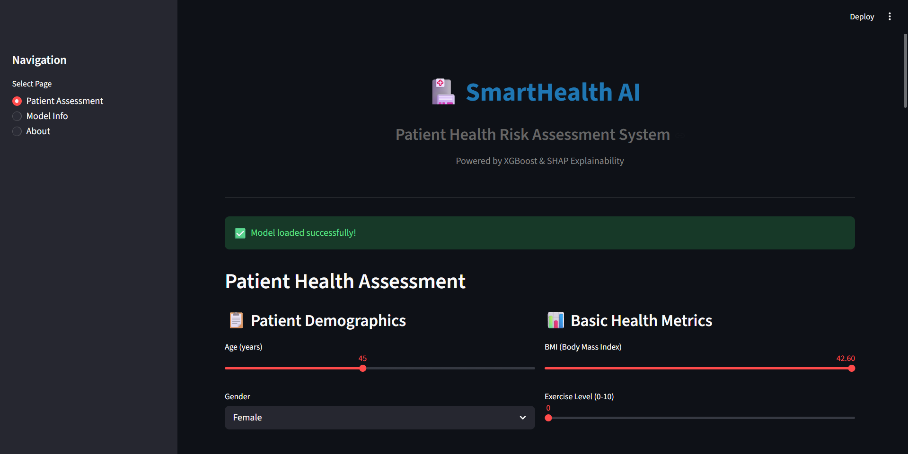
Front-End Application View
Key Features
🏥 HealthRisk AI
✓ Health Risk Score (0–1 scale)
✓ Multi-class output: Low / Medium / High
28
✓ SHAP feature importance chart
✓ Actionable lifestyle recommendations
7
✓ Historical tracking dashboard
✓ Downloadable PDF health report
✓ Mobile-responsive design
✓ Secure login & data encryption

Slide 9
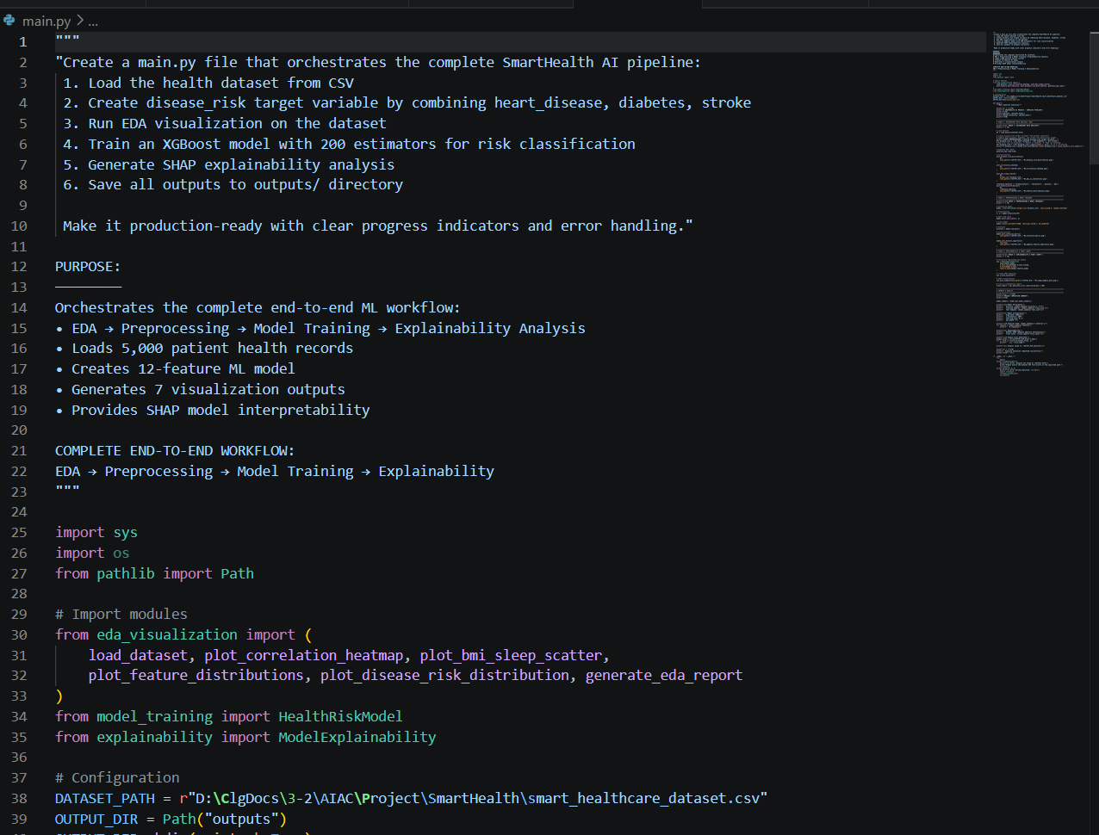
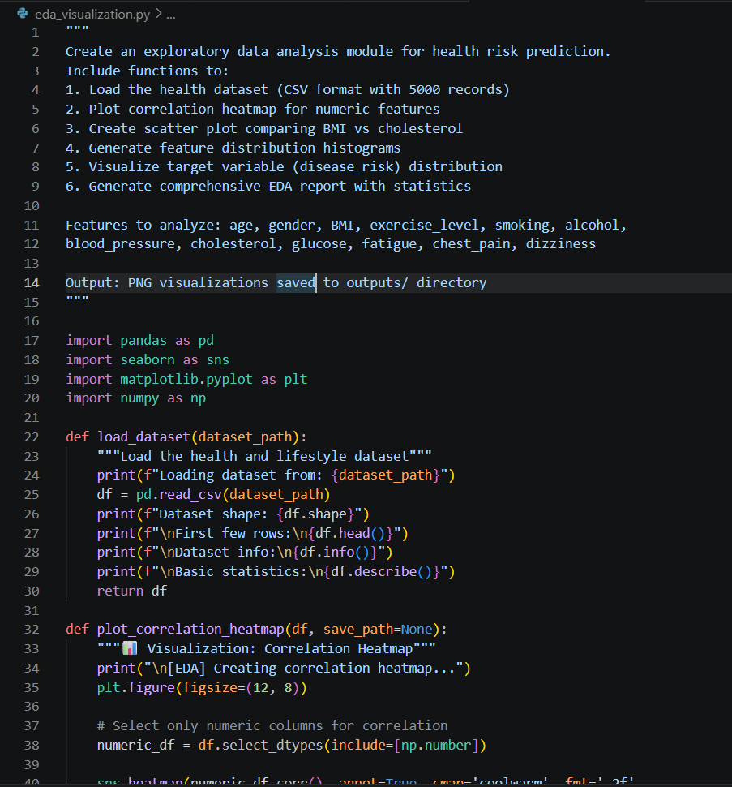
Proof of Prompts Generating Code

Slide 10
References
[1]
Chen, T. & Guestrin, C. (2016). XGBoost: A Scalable Tree Boosting System. KDD '16. ACM. DOI: 10.1145/2939672.2939785
[2]
Lundberg, S. M., & Lee, S. I. (2017). A Unified Approach to Interpreting Model Predictions. NeurIPS 2017. arXiv:1705.07874
[3]
Ribeiro, M. T., Singh, S., & Guestrin, C. (2016). LIME: Why Should I Trust You? KDD '16. arXiv:1602.04938
[4]
CDC / NCHS. NHANES (National Health and Nutrition Examination Survey). https://www.cdc.gov/nchs/nhanes
[5]
UCI Machine Learning Repository — Heart Disease Dataset. https://archive.ics.uci.edu/ml/datasets/heart+disease
[6]
WHO (2024). Global Health Statistics Report. World Health Organization. https://www.who.int/publications
[7]
Scikit-learn Documentation. https://scikit-learn.org/stable/ — Machine learning in Python
[8]
SHAP (SHapley Additive exPlanations) Documentation. https://shap.readthedocs.io/
[9]
OpenAI ChatGPT (2024). AI-assisted code generation tool. https://chat.openai.com
[10]
GitHub Copilot (2024). AI pair programmer. https://github.com/features/copilot

